Slide 1

Design Automation Warehouse using Programmable Logic Controller and QR Code Implementation for Invantarization

Slide 2







Electrical Engineering Study Program
Del Institute of Technology
Design Automation Warehouse using Programmable Logic Controller and QR Code Implementation for Invantarization
Presented by :
Ercherio Galang Dameross Marpaung 14S15056
Erikson Mangihut Tua Silaban 14S16028
Tommy Surimayanto 14S15017
Supervisor :
Guntur Purba Siboro, S.T.,M.T
Nama Penulis
2020

Slide 3

Overview
Introduction
Conveyor
Storage Shelf
Load Cell Sensor
Photoelectric Sensor
Conclusion

Slide 4


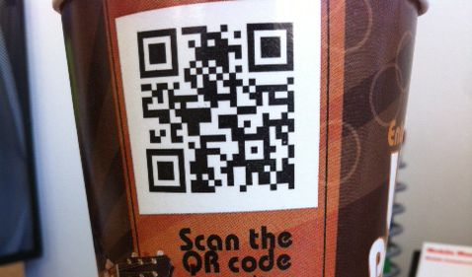
Introduction
Conveyor
Storage Shelf
Load Cell Sensor
Photoelectric Sensor
Conclusion
Problem
AUTOMATION SYSTEM
Solution
Automation Warehouse
The manual warehouse and manual inventory process requires a long time, the risk of accidents, and human error
OR Code Implementation for Invantarizaton

Slide 5
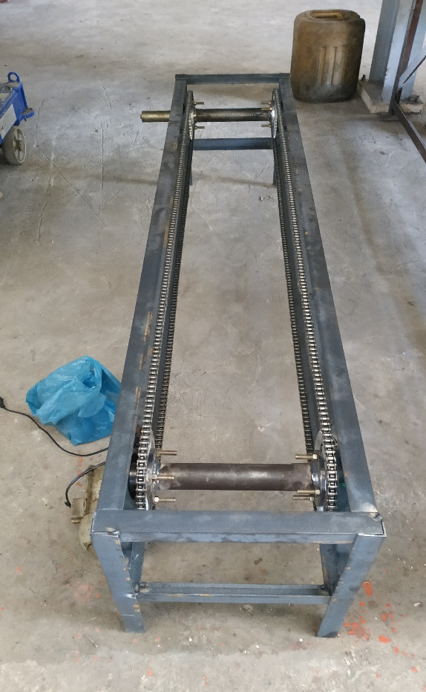
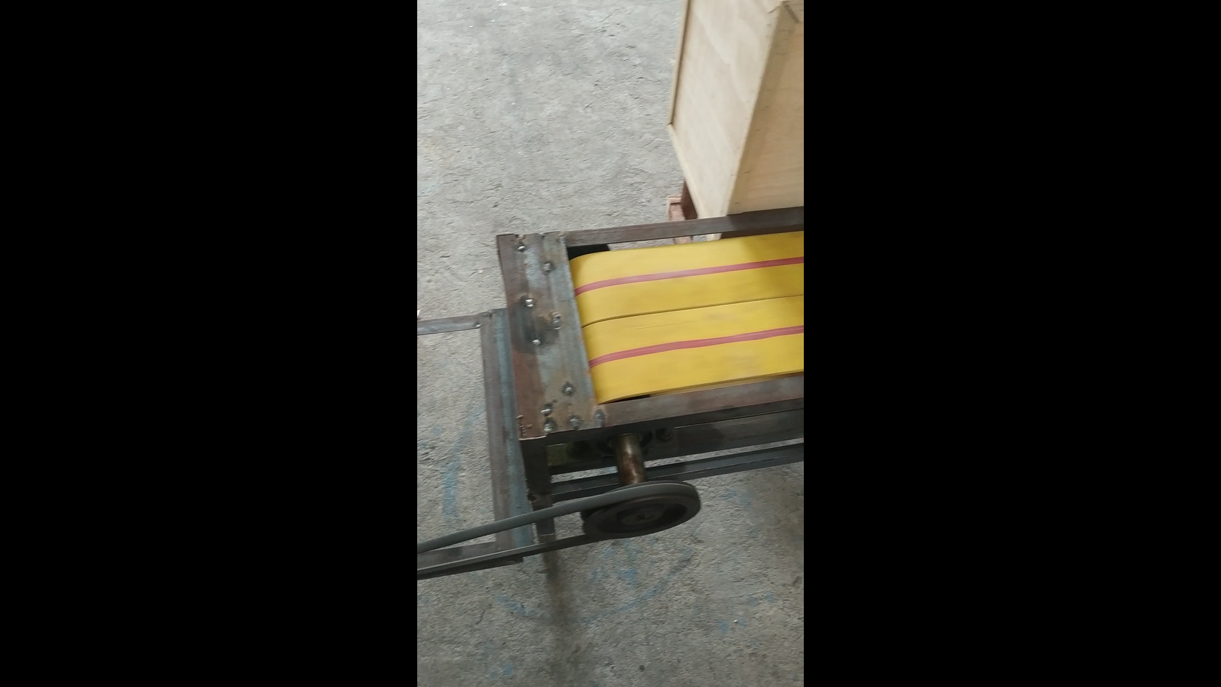
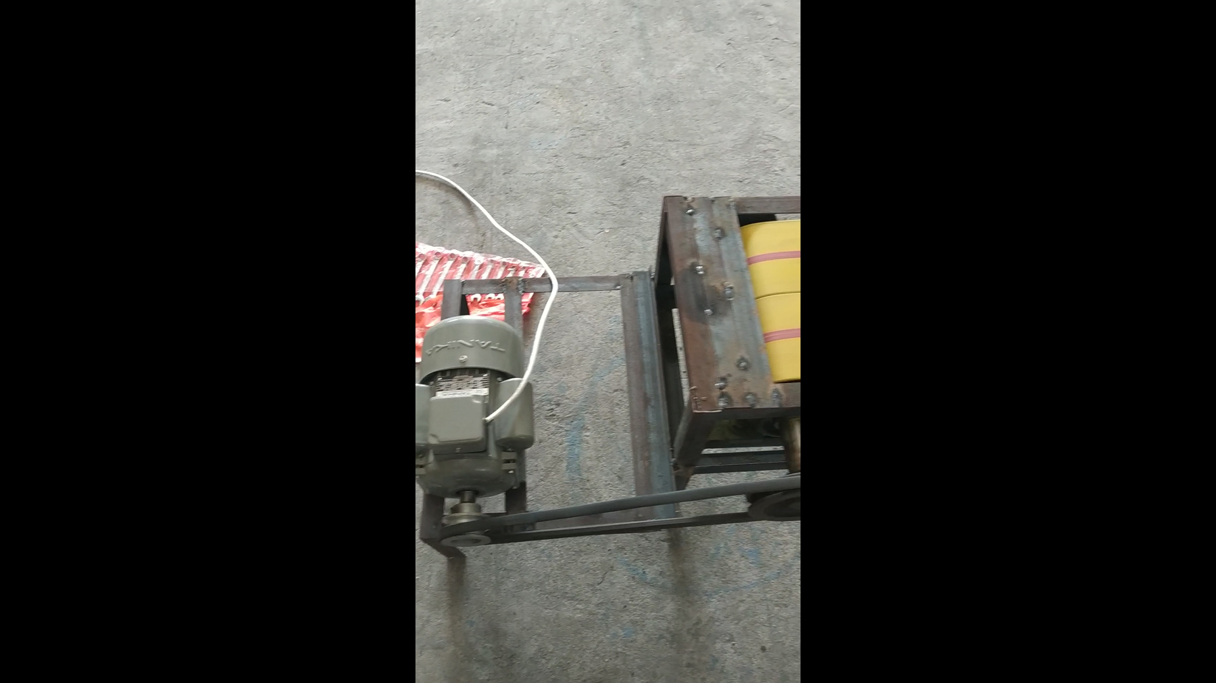
Introduction
Conveyor
Storage Shelf
Load Cell Sensor
Photoelectric Sensor
Conclusion
Frame Conveyor
Belt Conveyor
Motor Conveyor

Slide 6
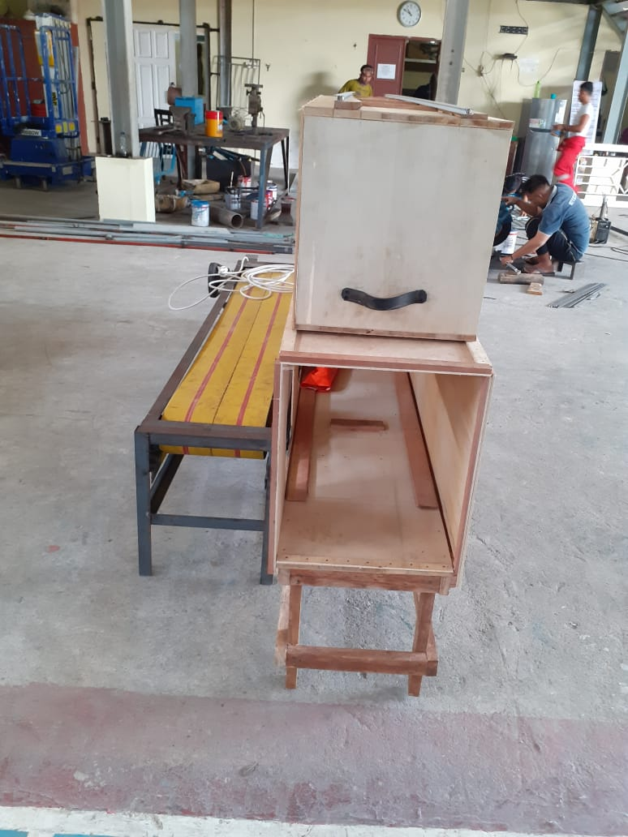
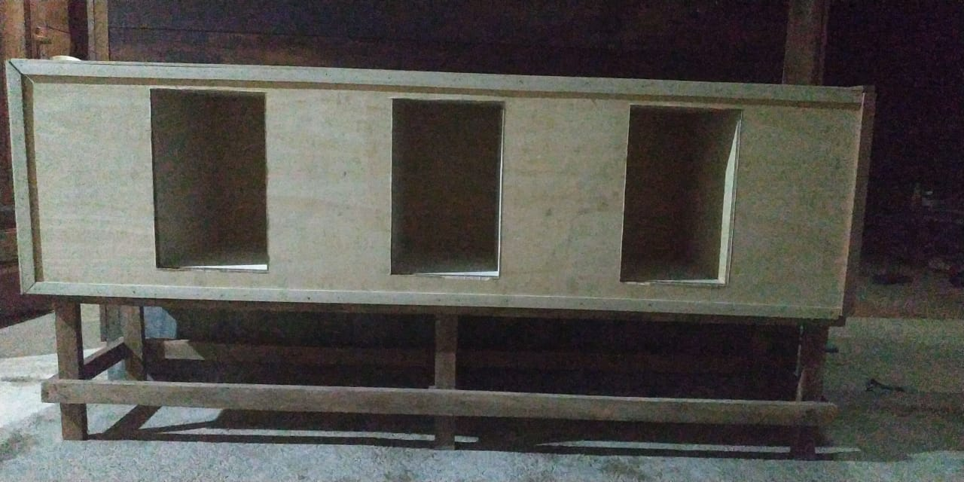
Introduction
Conveyor
Storage Shelf
Load Cell Sensor
Photoelectric Sensor
Conclusion

Slide 7
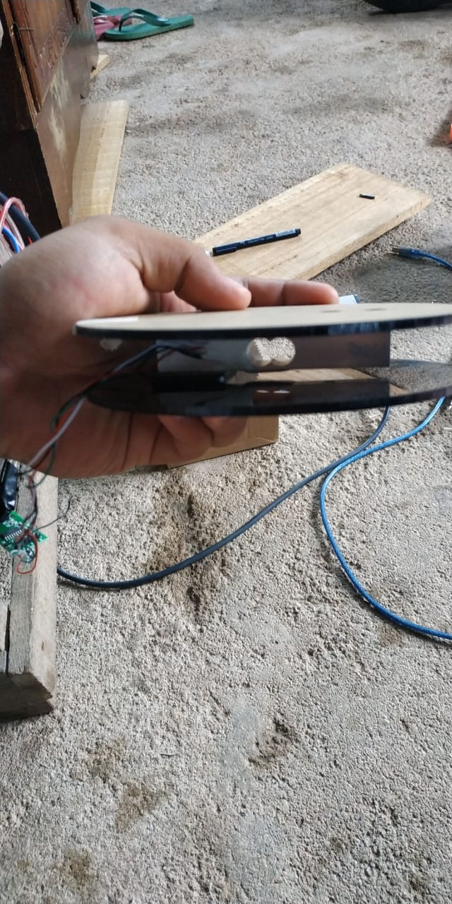
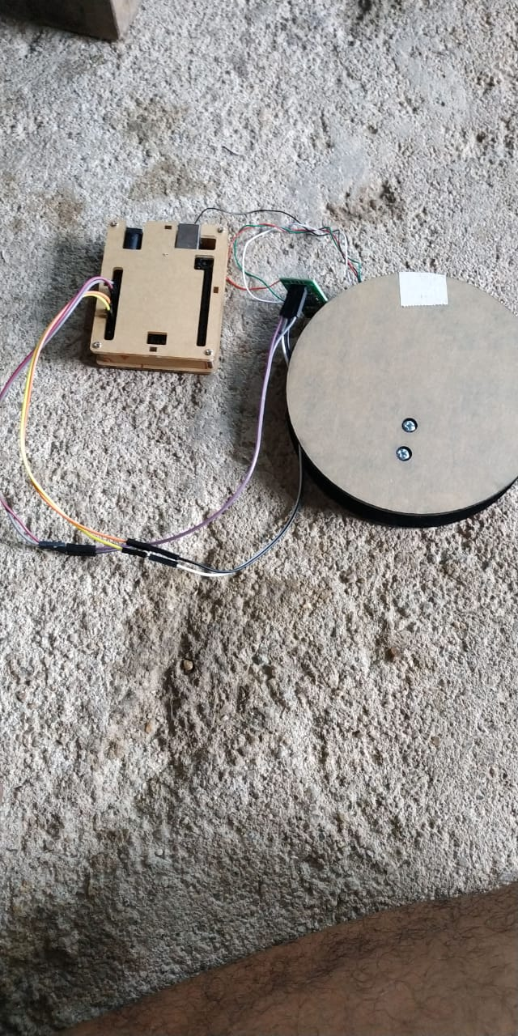
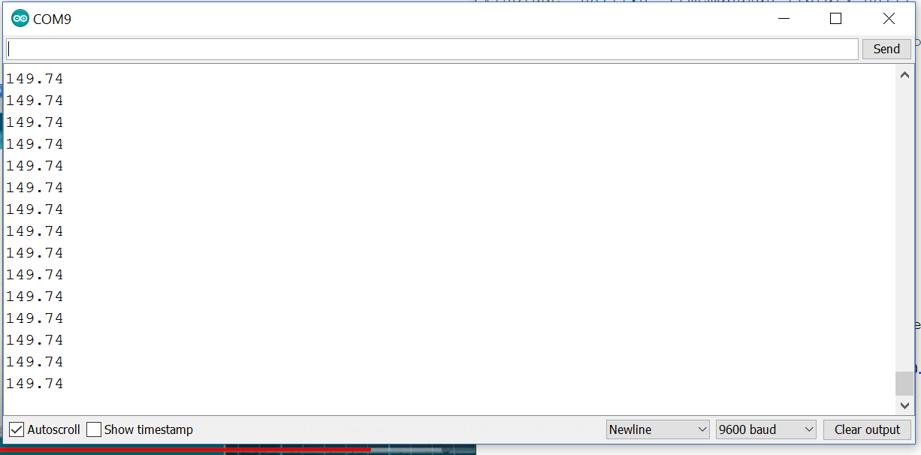
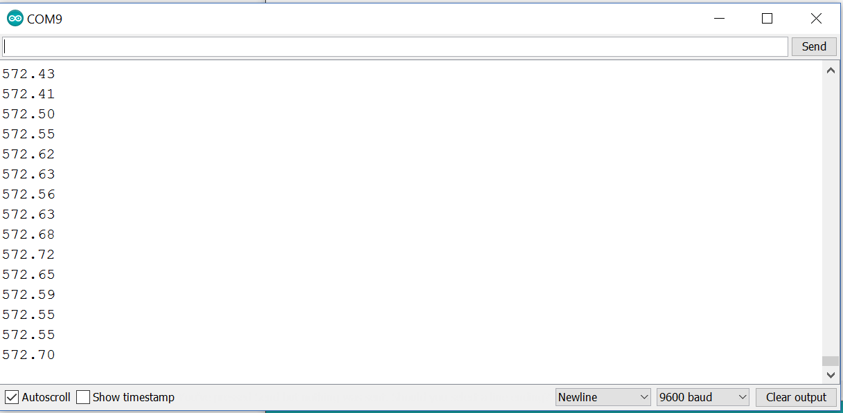
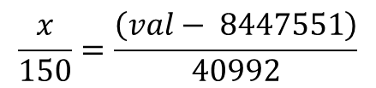
Introduction
Conveyor
Storage Shelf
LoadCell Sensor
Photoelectric Sensor
Conclusion
Use rasio Methode
$$\frac{x}{150}=\frac{\left(val− 8447551\right)}{40992}$$
150 gram
573 gram

Slide 8
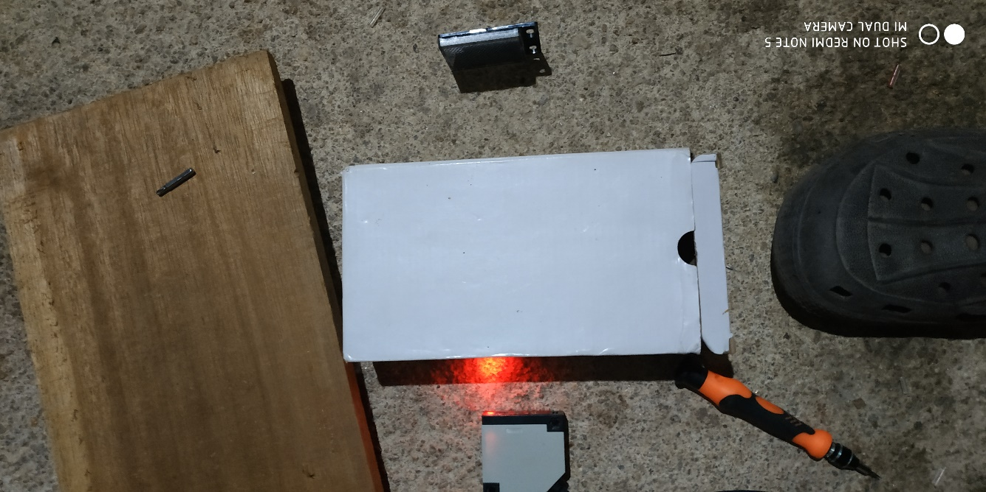
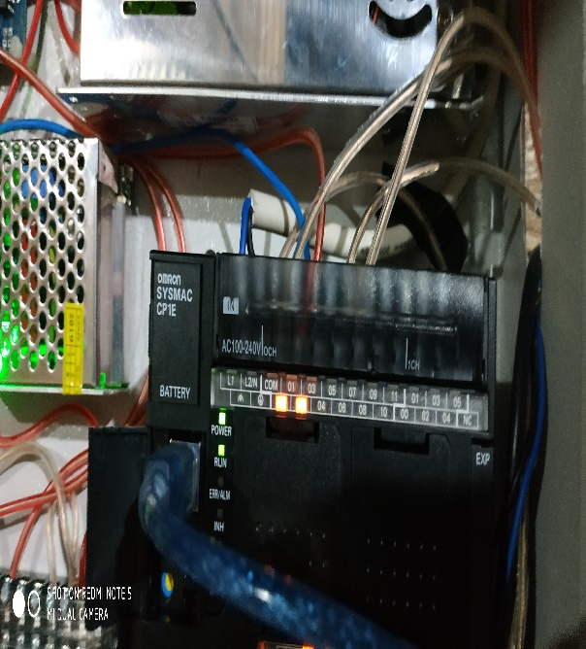
Introduction
Conveyor
Storage Shelf
Load Cell Sensor
Photoelectric Sensor
Conclusion
No. | Tinggi Benda {cm} | Sensor LOW | Sensor HIGH | Keterangan
1 | 7 | OFF | OFF | error
2 | 10 | ON | OFF | Pendek
3 | 12 | ON | OFF | Pendek
4 | 16 | ON | OFF | Pendek
5 | 21 | ON | ON | tinggi
6 | 30 | ON | ON | tinggi
7 | 11 | ON | OFF | pendek
8 | 20 | ON | ON | tinggi
9 | 4 | OFF | OFF | error
10 | 19 | ON | OFF | pendek
Sorry i failed to calculate the long of goods because my arduino pin is short circuit

Slide 9
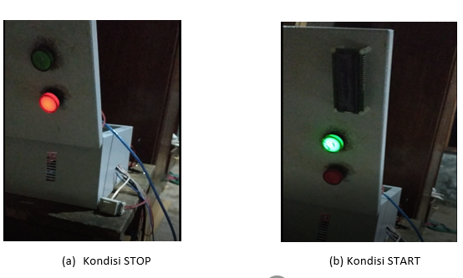
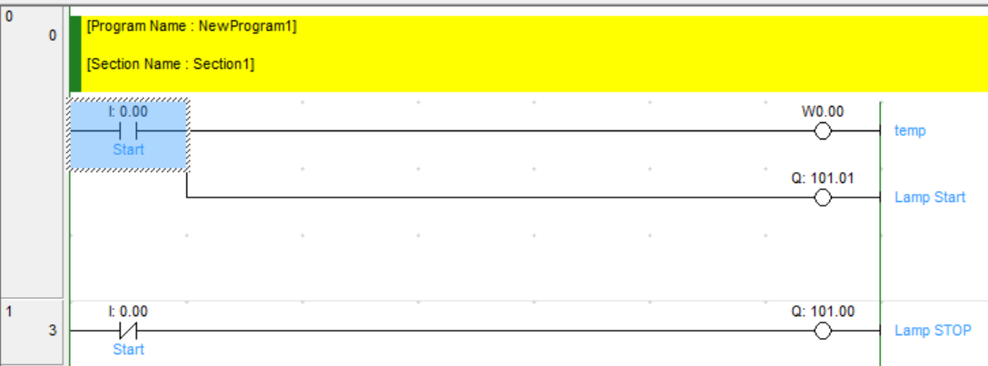

Introduction
Conveyor
Storage Shelf
Load Cell Sensor
System & Actuator
Conclusion

Slide 10
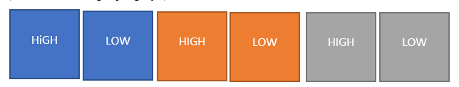
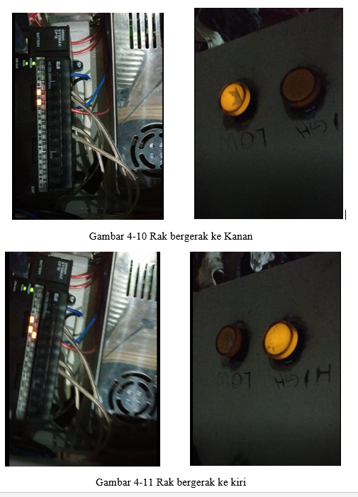
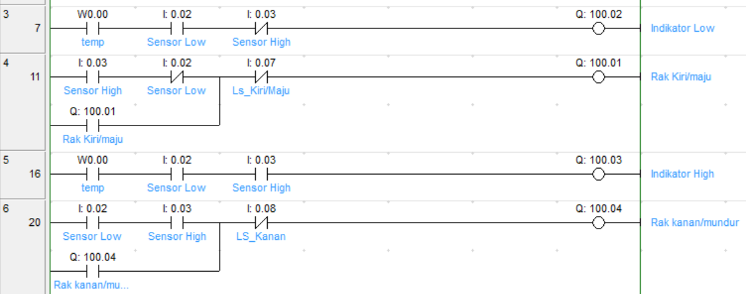
Introduction
Conveyor
Storage Shelf
Load Cell Sensor
System & Actuator
Conclusion
I not use actuator to slide the storage shelf. and to push goods to storing

Slide 11
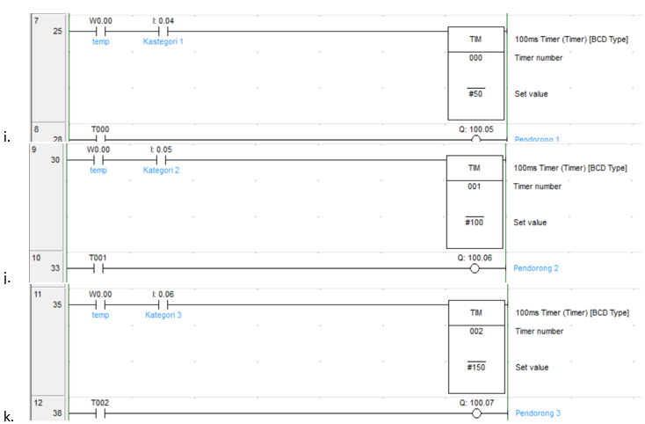
Introduction
Conveyor
Storage Shelf
Load Cell Sensor
System & Actuator
Conclusion

Slide 12
Introduction
Conveyor
Storage Shelf
Load Cell Sensor
System & Actuator
Conclusion
1. The design of an automatic soap maker tool system that was made successfully implemented and not going well. This is due to the need for motors with large lift, push and pull forces to lift large loads. Actuator components such as thrusters and rack drives are very expensive and of industrial scale.
2. The implementation of electronic circuits and component wiring is connected properly so that the system can be controlled via the Omron PLC CP1EN30DRA quite well, having problems in the PLC connection to Arduino with a 5 Volt relay intermediary short circuit occurs.
3. The process of sorting goods based on height using Omron CP1E N30DRA PLC can be done well, while long measurement cannot be done.

Slide 13


THANK YOU

